Slide 1
Presentation
I Am Sorry to Inform You That You Have Been Diagnosed with
Ebola Virus Disease
2026.05.18
By Coco

Slide 2
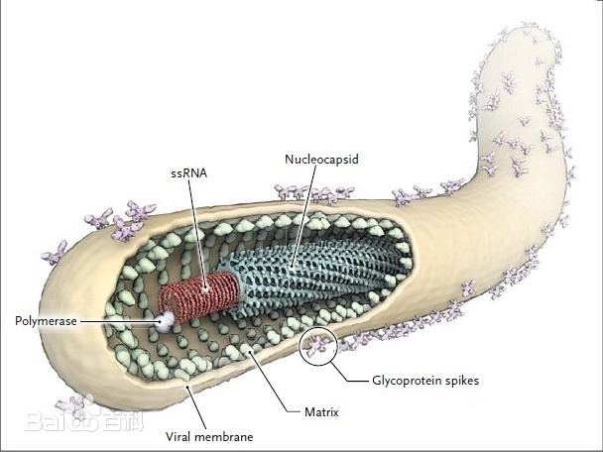
Various transmission routes
Animal-to-Human
Healthcare
Direct Contact
Contact with infected wildlife (e.g., fruit bats, nonhuman primates) or consumption of their undercooked meat ("bushmeat").
Funeral Practices
Needlestick injuries or contact with contaminated medical supplies.
Exposure to blood, secretions, or body fluids of infected or deceased people.
Washing the body of the deceased during traditional burial rituals.

Slide 3

What Symptoms Did You Experience?
Early Stage
Sudden onset of high fever (≥38.6°C)
Severe headache and muscle pain
Conjunctival injection (red eyes)
Progressive Stage
Severe watery diarrhea and projectile vomiting
Abdominal pain and dehydration
Maculopapular rash on trunk
Late Stage
Bleeding manifestations: gums, nose, stool
Neurological symptoms: confusion, seizures
Multi-organ failure and shock

Slide 4
What Treatment Is Available?
4 ways
Integrated Treatment and Management for High-Mortality Viruses
Vaccination
Supportive Care
Experimental Treatments
Critical Care
Approved Vaccine:​ Ervebo Vaccine (approved for Zaire ebolavirus).
Measures:​ Fluid and electrolyte replacement, maintaining blood pressure, and treating secondary infections.
Status:​ Ongoing clinical trials for new antiviral drugs and gene therapies.
Procedures:​ Intensive care support including mechanical ventilation and renal replacement therapy for severe cases.

Slide 5
What Is Your Prognosis for the Future?
Impact
Outlook
Sites of Viral Persistence:​ The virus may persist in immunologically privileged sites (e.g., eyes, testes, brain).
Mental Health Challenges:​ Survivors frequently face depression, anxiety, and psychological stress from social stigma.
Early Treatment Improves Survival:​ Timely intervention significantly increases the chances of survival.
Mortality Data:
Zaire Strain:​ Very high fatality rate, approximately 90%.
Bundibugyo Strain:​ Relatively lower fatality rate, around 30-50%.
Conclusion
Syndrome
Current Outlook:​ Survival rates are gradually improving with advances in treatments and vaccines.
Core Strategy:​ Prevention remains the most effective approach.
Protracted Recovery:​ Complete recovery may take several months.
Common Sequelae:​ Survivors often experience joint pain, vision impairment, hearing difficulties, and chronic fatigue.

