Slide 1
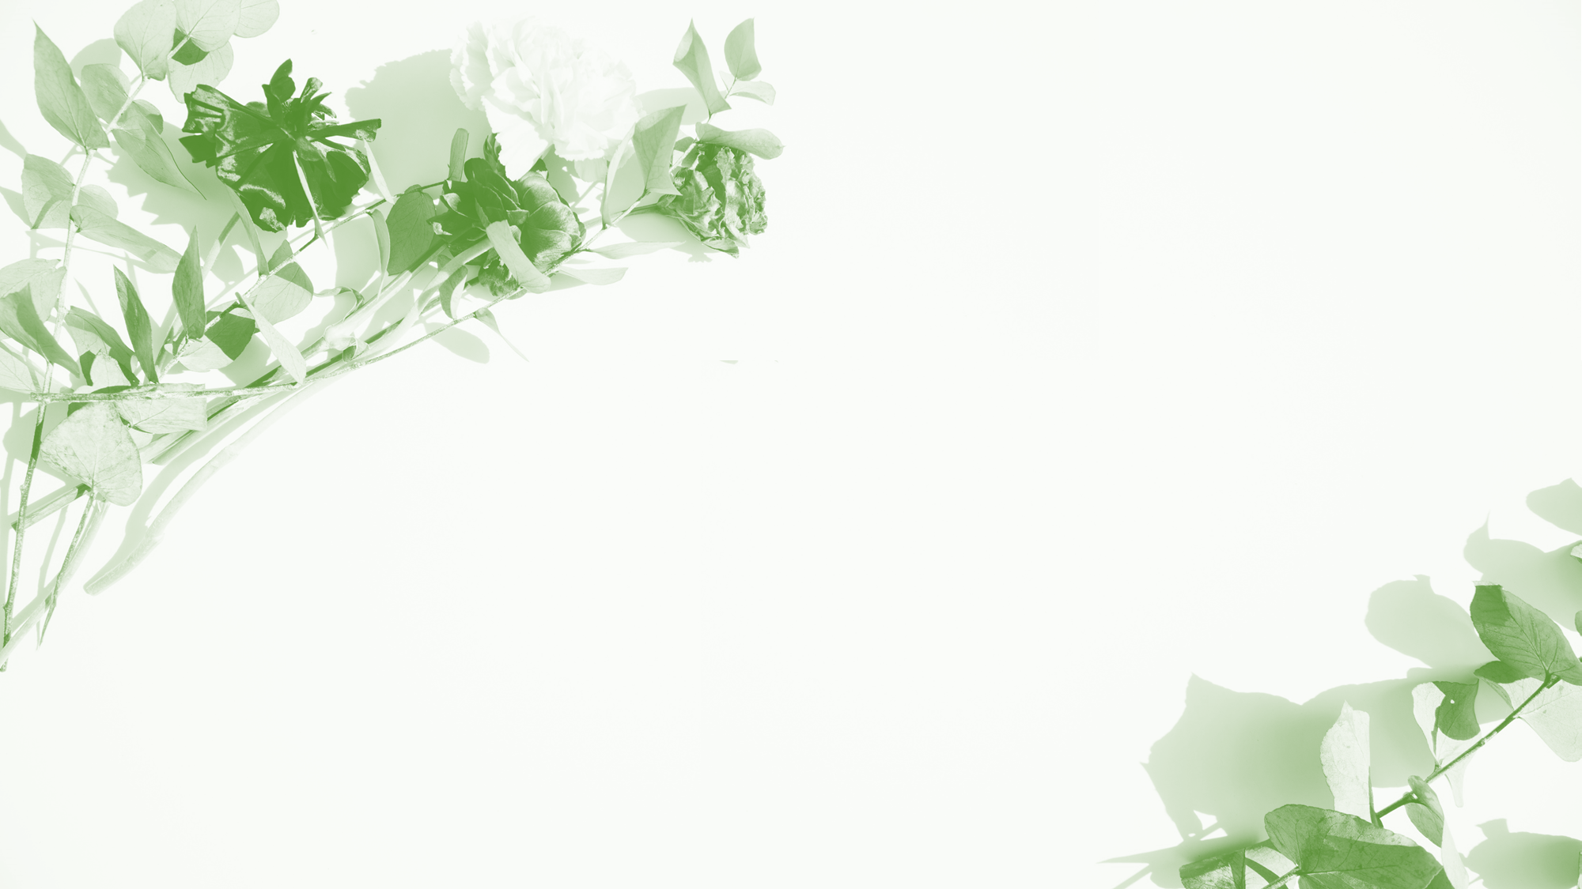
Genetic articles
By Coco

Slide 2

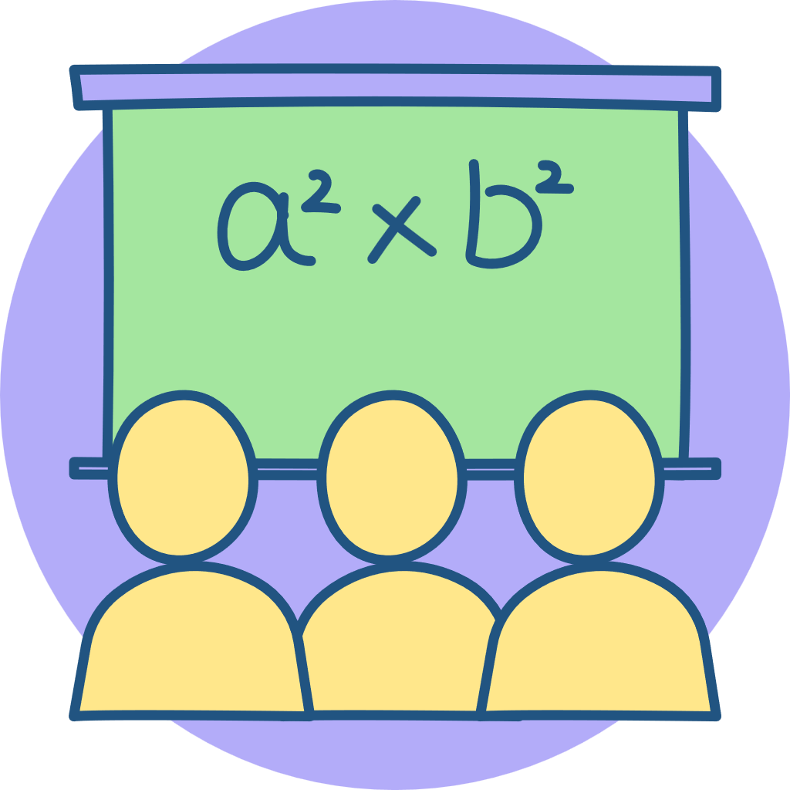
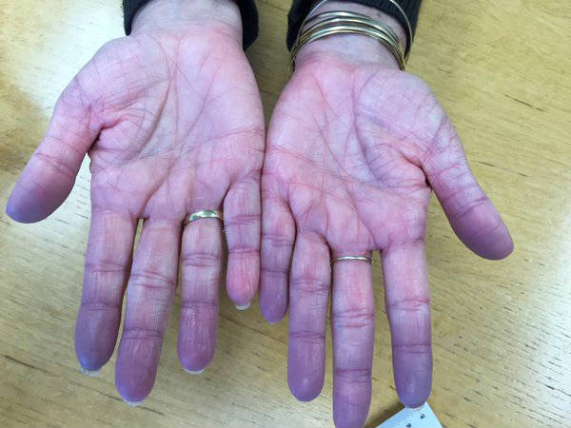
Case Study: The Blue Fugates
Methemoglobinemia: The "Blue" Blood Disorder
What is it?
Methemoglobinemia occurs when iron in hemoglobin is oxidized from Fe²⁺ to Fe³⁺.
Fe³⁺ is a non-oxygen-binding site.
This prevents oxygen binding and unloading at tissues.

Slide 3
Cause, Inheritance & Cure
Two Causes
Genetics
The Cure
Acquired:​ From environmental nitrates (soil/water).
This form causes health risks/death.
Inherited (Fugates):​ Due to a NADH diaphorase deficiency. Carries 10-50%​ methemoglobin with few health risks.
A single recessive genetic trait.
Requires one defective gene from each parent​ to appear in offspring.
Inbreeding did not cause the enzyme deficiency.​ It only increased the chance for the recessive trait to show itself.
~100 mg of methylene blue​ intravenously.
It acts to reduce Fe³⁺ back to Fe²⁺, reversing the blue skin color.

Slide 4
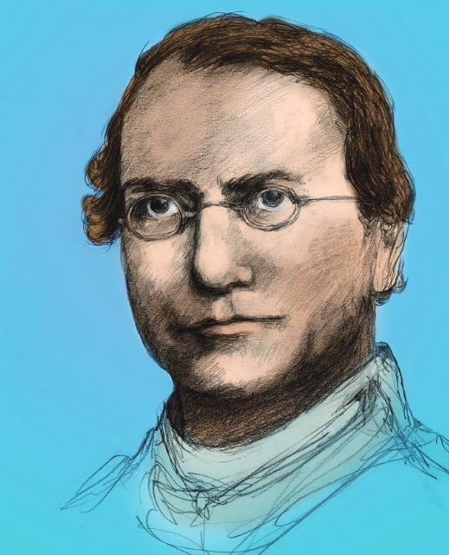
Gregor Mendel: The Father of Genetics
Mendel was an Austrian monk who loved science. He chose pea plants (Pisum sativum) for his research because they are easy to grow and have distinct traits (like tall/short or yellow/green).
He manually controlled pollination (mating) between true-breeding plants.
He kept detailed records and used mathematics to analyze his results, looking for patterns in ratios (like the famous 3:1 ratio).
Mendel discovered the fundamental laws of heredity (like the Law of Segregation).

Slide 5
From Mendel to Modern Tools: The Punnett Square
The "Shortcut"
The Basics
Beyond Mendel
While Mendel discovered the rulesof genetics, it was scientist Reginald Punnett​ who invented the Punnett Square​ as a simple visual tool to predict offspring genotypes.
Set-up:​ Place the mother's alleles across the top and the father's alleles down the side (or vice-versa).
Capital vs. Lowercase:​ Uppercase letters (e.g., T) represent dominant traits, while lowercase letters (e.g., t) represent recessive traits.
Combining:​ Draw the inner boxes to show all possible genetic combinations.
Mendel mostly looked at single traits (Monohybrid​ crosses).
The Punnett Square is a powerful tool that can handle multiple traits. As shown in the chart, we can use it for Dihybrid​ (two traits), Trihybrid, and even Tetrahybrid​ crosses to predict more complex probabilities.

Slide 6
Introduction to Human Mendelian Traits
Core Definition:
These are physical or physiological features controlled by a single gene​ with two alleles.
Their inheritance follows Gregor Mendel’s laws (dominance, segregation, independent assortment).
Key Takeaway:
Unlike complex traits (e.g., height), these are easily predictable using basic Punnett square analysis.
Common Examples (Contrasting Traits):
Red Hair:​ Recessive trait (requires two copies of the gene).
Attached Earlobes:​ Recessive trait (vs. Free earlobes which are dominant).
Widow's Peak:​ Dominant trait (a distinct point in the hairline).
Hitchhiker's Thumb:​ Recessive trait (thumb bends backward beyond 90°).
Cleft Chin:​ Dominant trait.

Slide 7

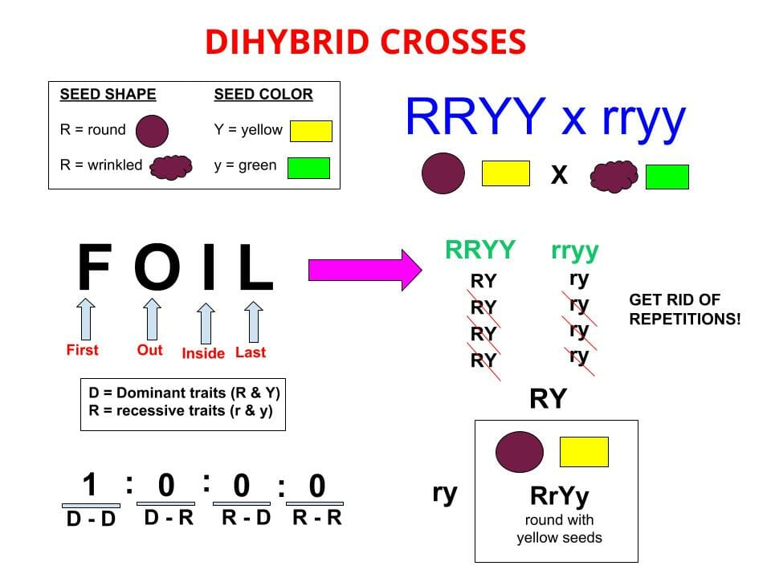
Introduction to Dihybrid Crosses
Dihybrid Cross: Beyond Single Traits
What is it?
A dihybrid cross examines the inheritance of two different traits​ simultaneously (e.g., height and seed shape in pea plants).
Unlike Mendel’s early monohybrid crosses (one trait), this deals with combinations like TtWw x TtWw.

Slide 8
Introduction to Dihybrid Crosses
Dihybrid Cross: Beyond Single Traits
The Logic Behind It
Possible Combinations
Each trait is controlled by a separate gene with its own alleles.
Genes for different traits (like T/t and W/w) are inherited independently. This means the allele for tallness (T) can pair with either wrinkled (W) or smooth (w) seeds.
An individual with both heterozygous traits (e.g., TtWw) can produce four types of gametes: TW, Tw, tW, and tw. This creates more complexity than a single-gene cross.

Slide 9
The Famous 9:3:3:1 Ratio
The Grid (16 Boxes)
Decoding the Ratio
Why This Matters
When crossing two dihybrids (TtWw x TtWw), the Punnett square expands to a 4x4 grid (16 boxes). This represents all possible zygote combinations.
After filling the grid, we get a classic phenotypic ratio of 9:3:3:1:
9/16​ show both dominant traits​
3/16​ show Dominant Trait #1 + Recessive Trait #2​
3/16​ show Recessive Trait #1 + Dominant Trait #2​
1/16​ show both recessive traits​ (e.g., Short & Smooth).
This ratio proves that the inheritance of one trait does not influence the inheritance of another (Mendel’s Law of Independent Assortment).
These principles are foundational for biology exams and understanding genetics.

Slide 10
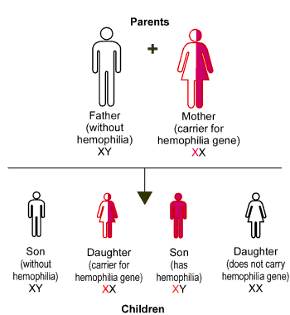
Sex-Linked Genetics
When Genes Have a Gender Bias
Location, Location, Location
Unlike traits on autosomes (non-sex chromosomes), sex-linked traits are controlled by genes located specifically on the sex chromosomes​ (X or Y).

Slide 11
Sex-Linked Genetics
When Genes Have a Gender Bias
Crisscross Inheritance
Visual Representation
Because males have only one X chromosome (inherited from their mother), they are more likely to express recessive traits.
This creates a pattern where a mother can pass a trait to her son (who then shows it), creating a "crisscross" pattern in pedigrees.
We use standardized symbols in pedigrees: Squares represent males, and circles represent females.

Slide 12
Case Studies:
Fruit Flies and Human Visio
The "Fruit Fly" Experiment
Human Example: Color Blindness
Genetic Counseling
Scientist Thomas Hunt Morgan discovered the first sex-linked trait in fruit flies: white eyes.
He found that only male flies​ had white eyes when he crossed red-eyed parents. This was because the gene for eye color resides on the X chromosome.
Just like the flies, human red-green color blindness is much more common in males (8%)​ than females (1%).
Why? Males only need one​ recessive allele to be colorblind, whereas females need two.
Understanding these patterns is crucial for predicting the risk of passing on genetic disorders like hemophilia or Duchenne muscular dystrophy.

Slide 13
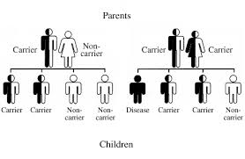
Recessive Disorders
Genetics 101
The "One in Four" Rule
Recessive traits often "hide" in carriers. If two carriers (heterozygous) have a child, there is a 25% (1/4) chance​ the child will express the disorder.
This is visualized using a simple Punnett square (e.g., attached earlobes vs. free earlobes).

Slide 14
Recessive Disorders
Genetics 101
Carriers: The Silent Passengers
Why Mendelian Genetics Still Matters
An individual can carry a mutated gene without showing symptoms.
For the trait to appear, the individual must inherit two copies​ of the recessive allele (homozygous recessive).
Many physical traits follow this simple dominant/recessive pattern (e.g., earlobe attachment, tongue rolling, hitchhiker's thumb).

Slide 15
When Recessive Genes Cause Disease
High-Risk Groups
The "On/Off" Switch
Examples of Severe Recessive Disorders
Some recessive disorders are more common in specific populations due to shared ancestry. For example, Tay-Sachs​ is more frequent among people of Ashkenazi Jewish descent
With dominant disorders , inheriting one bad gene turns the disease "ON."
With recessive disorders, the disease is only "ON" if both genes are broken.
Cystic Fibrosis :​ Affects mucus production, causing breathing difficulties and lung infections.
Phenylketonuria :​ A metabolic disorder that, if untreated, leads to intellectual disability.
Tay-Sachs:​ A fatal neurological disorder with no cure.

Slide 16
​ Dominant Genetic Disorders
Huntington's Disease:
Marfan Syndrome
ourette's Syndrome
A fatal, late-onset neurological disorder.
A connective tissue disorder causing tall stature and cardiovascular risk.
A condition characterized by motor and vocal tics
Inheritance Pattern:​
An affected parent has a 50% chance of passing the disorder to each child.

Slide 17
Hypertrichosis: A Rare Condition of Excessive Hair Growth
Core Definition
Classification
Inheritance & Causes
It is a rare, non-hormonal genetic condition characterized by excessive hair growth​ covering the face and body.
It can be present at birth (congenital) or develop later in life (acquired).
Generalized Hypertrichosis:​ Affects large areas of the body.
Localized Hypertrichosis:​ Affects specific areas (e.g., a single limb).
Terminal vs. Vellus:​ Terminal hair is thick and pigmented (like adult hair), while vellus is fine and downy.
Often inherited in an X-linked dominant​ pattern, though sporadic mutations can occur.
It is caused by changes in specific genes (e.g., SOX3) that affect hair follicle growth.

